Slide 1
Drinking Coffee Elsewhere
Ortal Lieberman
Brittany Haskins
Jillian Wilson
Michelle Fedoruk

Slide 2
Drinking Coffee Elsewhere
8 stories, related themes:
Issues of identity- characters who straddle two worlds- choosing an alliance
Race Awareness- coming to terms with ‘an unstoppable evil’ in the world (Brownies), awareness of the “other”
Racial Segregation/ Prejudice- Relations of white/black characters and their cultures
Not always a happy ending- ends with a realization, or some sort of coming to terms

Slide 3
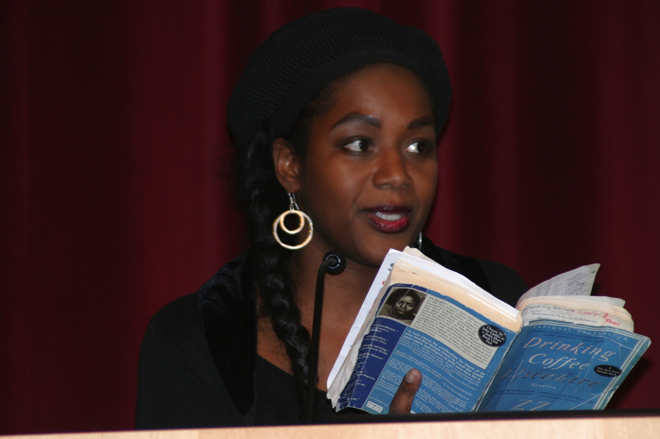
ZZ Packer
ZZ (Zuwena) Packer
“ZZ” was a childhood nickname
Grew up in Atlanta, Georgia and Louisville, Kentucky
First published work in Seventeen Magazine, at age 19
Received a B.A. from Yale, M.A. from Johns Hopkins, and M.F.A from University of Iowa

Slide 4
An Interview With ZZ Packer Writers Digest
WD Interview Link
Q:. For you, what characteristics make the most powerful stories?
A: Voice and resonance.
Voice= character-based, Style= author-based
“There is a certain inescapability to certain stories in which the author has found the right voice for the story or for the character; they are a bit like car wrecks or ambulance sirens: we have to look at a wreck, we can’t help but hear the sirens.”
“At some point the writer must ask himself in what way the story is also universal, for all good stories are both particular and universal.”
Universal/ Philosophical endings to stories in Drinking Coffee Elsewhere

Slide 5
An Interview With ZZ Packer Writers Digest
Q: Many of your stories deal pointedly with race issues. What benefits and challenges do these issues bring to your work and to you as a writer?
A: “I think a lot of my characters wish race didn’t matter as much as it does, but it does…You don’t have the luxury of being able to decide whether or not to pay attention to race, because if you don’t, someone else will…”
“Racism, sexism, and all other attempts for one group to dominate another …pushes humans to their limits—not just their physical or emotional limits, but the limits of self-conception, what it means to be, to exist…”
Racism & sexism provide fuel for individual characters

Slide 6
In One Word: Impotence The Short Review- Elaine Chiew
Article Link
“What struck me as I reread this collection was how apt the word impotence is in conveying the state of mind of most of the protagonists. Impotence, powered by a subterranean rage.”
“Lacking in power to act effectively; helpless”- The Online Dictionary
“When you ‘ve been made to feel bad for so long, you jump at the chance to do it to others” (D.C.E., Brownies)
Can you find examples where passive, repentant aggression ultimately let go?

Slide 7
Examples/Roles of Impotence in D.C.E.
Every Tongues Shall Confess: Sister Clareese, a staunch born-again, abandons an amputee without so much as a heartlong glance as he crashes to the floor
Our Lady of Peace: Lynnea, a school-teacher driven by impotence and rage over her inability to make a difference to her black students, drives away after running over two boys in a bad neighborhood
Drinking Coffee Elsewhere: Dina allows a hardened patina of indifference to glaze over her friendship with a white girl whose mother had just died
The Ant of the Self: Spurgeon, a boy taken by his loser father to the Million Man March with a hare-brained scheme to sell exotic birds, finally loses it in a match of fisticuffs with his father, only to end up in a train station, lost, penniless, with little by way of finding his way home
How does impotence affect characters in the story Geese? In Doris is Coming?

Slide 8
Brownies
A black troop discovers that the white girls at their camp are in fact, delayed learners.
Irony doubles when black girls have no hesitations at calling the white girls, “retarded”, while they are outraged over the term “nigger”.
“We can’t let them get away with that,” Arnetta said, dropping her voice to a laryngitic whisper. “We can’t let them get away with calling us niggers. I say we teach them a lesson.”

Slide 9
In-Class Readings
Black Sexual Politics
“Racism both empowers and weakens”- empowers the girls when told they were called a “nigger”, allowing them to stand up for themselves, however also works against them as it makes them more prone to impose that hatred on another group (white troop).
Black Feminist Thought
“Racism is gender specific”, ‘Until women gain their rights, no group is free’- problems in Brownies are gender specific problems- stereotypes of white girls motivated by appearance : comment on their hair, compare thei smiles to the white news anchors.

Slide 10
Patriarchal Society
Position of respect given to fathers regardless of their actions- children do not taint the measure of respect given to fathers
Daphne’s Father: “My Father The Veteran”- repetitive, important to narrator
Laurel’s father: Tells girls of other end of racism, “My Father Told Me So”- undisputed truth and respect
However at end, Laurel realizes her father contributed to an “Unstoppable Evil in the World”- perfect image of her father is cracked- critically judged and questioned

Slide 11
White Until Otherwise Told
Troop 909- didn’t outright say race until later in story. If this weren't a women's writers class, would you have known before the narrator told? Even guessed?
The White disabled girls- also white until otherwise told
Don’t know Heidi is a lesbian until told otherwise
Practice is both a literary tradition and a social/cultural one

Slide 12
Our Lady of Peace
Lynnea moves to Baltimore after being robbed at her dead-end job and decides to get a teacher’s certificate.
The students misbehave and are not motivated.
Sheba, a girl who transfers to this school because knifed one of her last teachers, tames the students and motivates Lynnea to be a better teacher.
Lynnea learns that Sheba is pregnant and wants to help. She quits teaching, but realizes she can do nothing for Sheba who is unforgiving and speaks up for every pissed-off kid in the world: “C’mon. Make me” (81).
Race Awareness- coming to terms with ‘an unstoppable evil’ in the world.
Does Lynnea gain a racial awareness?
What does this story tell us about the real world as future teachers?

Slide 13
The Ant of Self
Spurgeon
Intelligent, does debates
Looks down at his father
Father
Just got a DUI
Calls cops “pigs”
Former Black Panther
Bad with money
Issues of identity
Spurgeon: “‘I’m the only black kid in my class. Like a fucking mascot or something’…’I just get tired of it’” (106).
“Does anybody understand themselves?” (109).
How do you think Spurgeon identifies himself?
Notes:
“I was quiet and small, and not rowdy like they expected black guys to be”(85-6).

Slide 14
Drinking Coffee Elsewhere
Dina:
African American college
freshman and narrator and
main character of the story.
During “get to know you”
activities, she states that if she
could be any object, she’d be
a revolver. She is forced into
counseling after this, and into
a single dorm room.
Throughout her first year at
Yale, she reveals her tendency
to want to be alone, and her
gradual and hesitant
realization of self and
sexuality.
Heidi/ Heinrick:
White Canadian college freshman, who becomes Dina’s close friend. Heidi, who wants to be called Heinrick, is also ostracized by the bulk of Yale society (and society in general).
She reaches out to Dina because she recognizes her as a fellow outcast. The pair eventually become very close friends.
During their friendship, Heidi and Dina become very close friends, leading the two to realize things about themselves. Dina begins to question her sexuality, although reluctantly. Heidi comes out as a lesbian during“Coming Out Day.”
After this, Heidi is pushed away by Dina, who is afraid of what their sexuality may mean.

Slide 15
Speaking in Tongues
Tia: pre-teen African American girl who lives with her ultra-religious aunt in a small town, due to her mother’s drug problem. After growing frustrated with her religious education and home life, she decides to run away to Atlanta to live with her mother. During her time in ATL, her lack of money and shelter leads her to Desi, who wants to take care of her. During her stay with Desi, she encounters sexual experiences, and a new type of control– that of a man, rather than that of religion.
Marie: Desi’s “business partner” who works as a prostitute in order to save money to buy a condo for her and her children to live in. At the close of the story, she tells Tia to go home, and even gives her money and physically wards off Desi in order for Tia to leave. Marie– who has already lost her innocence at the hands of Desi and those like him– wants to prevent Tia’s ultimate loss of innocence, although it has already begun after her experiences with Desi.
Desi: 30-something African American male who encounters Tia in ATL. He makes his money by dealing drugs and pimping Marie. He lures Tia in by offering her support and care, but later tries to force her to have sex with him and stay in his apartment. He later uses physical force to try to keep Tia with him and prevent her from going back home.

Slide 16
Geese
The main character is Dina, who leaves Baltimore to live in Tokyo, Japan “for loveliness.”
Has a job for the summer where she meets Ari, but eventually becomes jobless. Eventually she moves in with Ari, who has two other foreign roommates, Petra and Zoltan. After a while another man, Sayeed, comes to live with them.
All of the roommates are unemployed, and they begin to steal food from their neighborhood.
The roommates go to the park together when Ari announced he has lost his job. Out of nowhere, Zoltan begins to chase the geese at the park, causing a scene.
Dina eventually has sex with a Japanese businessman for money. On her way home, she thinks about the Kamikaze pilots she learned about in school.

Slide 17
Geese
“Or rather, it wasn’t really a plan at all, but a feeling…She did not want to say it, because it made no practical sense, but in the end she went to Japan for the delicate sake cups, resting in her hand like a blossom; she went to Japan for loveliness. ” (p.211)
“Even though she never would have stolen anything in America, stealing in Japan gave Dina the same giddy, weightlessness that cursing in another language did. You did it because it was unimportant and foreign.” (p. 225)
“She remembered how she’d marveled when she’d read it, amazed that anyone would do such a thing; how—in the all-knowing arrogance of youth– she’d been certain that given the same circumstances, she would have cone something different.” (p. 233)

Slide 18
Doris is Coming
Doris Yates is a young religious girl. Her mother cleans for a Jewish family, and she helps her mother by cleaning their church. The story is set in 1961
The daughter of the Bermans, Olivia, comes to the service at their church to meet Doris and to “find out about Christian salvation.”
Olivia goes to the same school as Doris, and talks to her as “a favor.” Doris proclaims, “I don’t need anyone to talk to. Especially not white people. I talk to my family. I talk to my pastor.”(p. 245)
Doris is friends with the owner of a shop down the street, Mr. Stutz.
Doris wants to go to a sit-in, but others continuously try to persuade her it is not a good idea.
Livia eventually says she is leaving, and that, “…t real crazy people are the ones who do the same thing over and over again? Expecting a different result every time?” (p.259)
After finding out Stutz was closing his shop, Doris walks to a store that only serves white people. She sits at the counter and does her homework, even though the staff tells her to leave. The staff begins to make small talk with her. Eventually, the waitress gives Doris the last half of her shake, and Doris leaves.

Slide 19
Key Quotes
When Stutz says a sit-in would not be good for Doris, she replies, “What do you mean ‘not so good’? You think I should just walk around and not care that I have to use a separate everything! That my father shouldn’t be able to vote!”(p. 248)
When she talks to the Reverend about wanting to go to a sit in, he says, “Do you wanna starve, but keep your house with a hilltop view? Or do you wanna live in the valley with a full belly?”(p. 251)
“Alice had annoyed her, offended her, but she didn’t see any sense in doing anything about it. Acknowledging too much just made it hurt worse. Livia’s self-satisfaction and self-righteousness felt just as bad as Alice’s thoughtlessness.” (p.255)
“I just want you to know I’m leaving now. Not because you’re making me or because I feel intimidated or anything. I just have to get home now.”(p.265)

Slide 20
Identity: Race and Sexuality
Throughout Drinking Coffee Elsewhere, the idea of identity– what it means and how it can change– is very evident. Race and sexuality seem to be prime factors in determining identity in this story.
Which aspect(s) of identity did Dina seem to be most affected by?
Which aspect(s) of identity did Heidi seem to be most affected by?
Why might these aspects look different in each character? Where do we see this in modern society and media?

Slide 21
The Loss of Innocence
Example: In Speaking in Tongues, Tia comes from a small town and ultra-religious upbringing. It is clear that she is young and innocent at the start of the story. After her experiences with sexuality with Dezi and Marie in Atlanta (Dezi pressuring her to have sex and exerting physical dominance over her, and learning about Marie’s lifestyle), it becomes clear that she has lost a great deal of that innocence, and far too young.
Get into groups and discuss how you saw a character’s loss of innocence in one of the stories. Give examples of events you think led up to that loss of innocence.

Slide 22
Religion’s Power Over Women
The Purity Myth– “The Virginity Movement’s War Against Women”
This documentary espouses the idea that “boys have been taught that the things that make them men—good men– are transcendent ideals like courage and honesty and integrity. Girls, on the other hand, have been led to believe that a woman’s moral compass lies somewhere between her legs, literally.”
http://www.youtube.com/watch?v=96n25hvuOTw

Slide 23
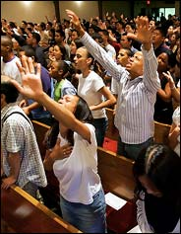
THE PURITY MYTH
Evangelical Christians
Political activists/ policy wonks
SUBMISSIVE WOMEN…
Every Tongue Shall Confess? Others??
Speaking in Tongues?

Slide 24
What Do You Think?
How does this video and ideology apply to stories in Drinking Coffee Elsewhere?
In what ways do we see women being constrained by religion/religious ideals/these concepts of femininity and sexuality?

